Slide 1
northwind sales Data analysis

Slide 2

TOOL USED TO ANALYSIS NORTHWIND SALES
Sql Server Managment Studio 18

Slide 3
TABLES IN NORTHWIND SALES ANALYSIS
dbo.Categories
dbo.CustomerGroup
dbo.products
dbo.Customers
dbo.suppliers
dbo.employees
dbo.shippers
dbo.orderdetails
dbo.orders

Slide 4
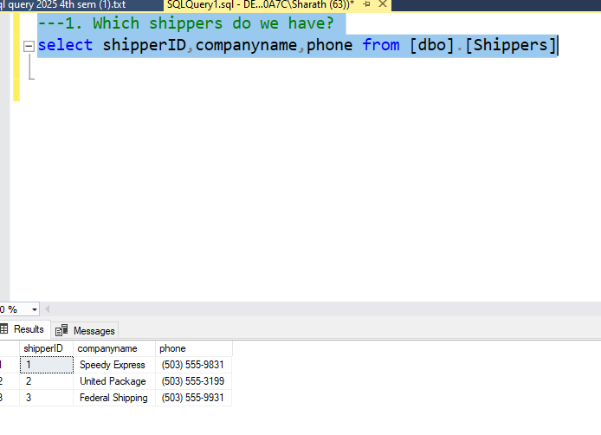
question
1.which shippers do we have?
query
select shipperID,companyname,phone from [dbo].[Shippers]
output

Slide 5
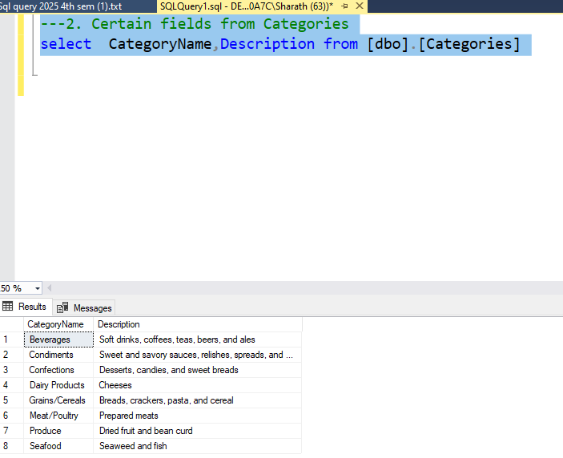
2.certain fields from categories
question
2.certain feilds from categories
query
select CategoryName,Description from [dbo].[Categories]
output

Slide 6
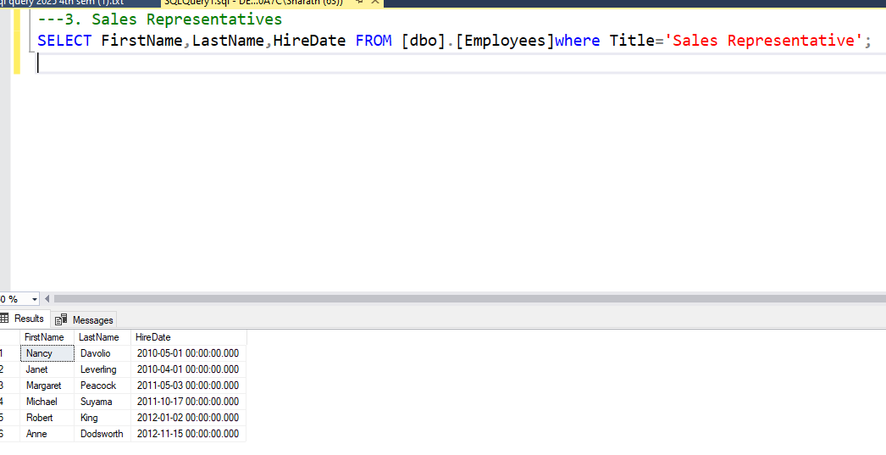
2.certain fields from categories
question
3.sales representatives
query
SELECT FirstName,LastName,HireDate FROM [dbo].[Employees]where Title='Sales Representative';
output

Slide 7
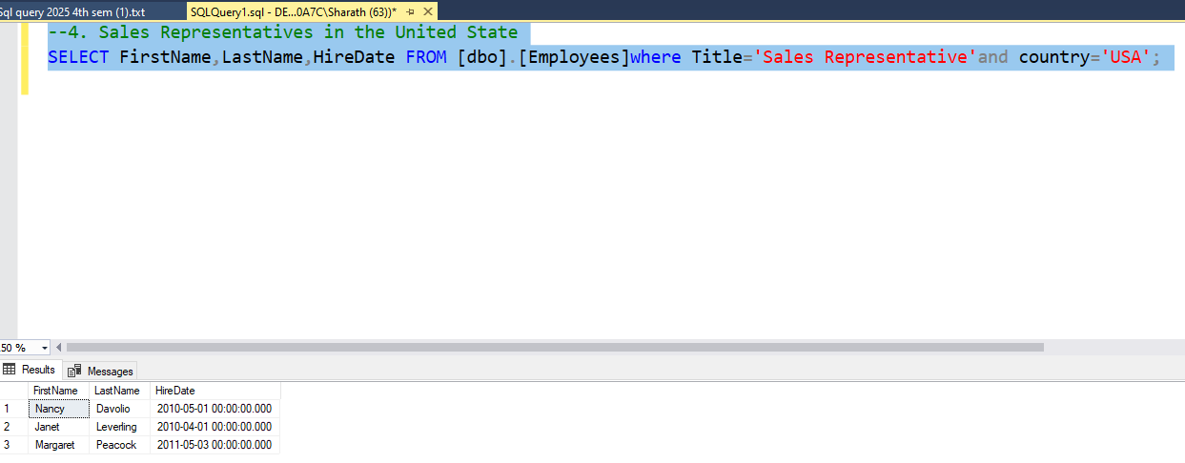
2.certain fields from categories
question
4.sales reperesentatives in the united states
query
SELECT FirstName,LastName,HireDate FROM [dbo].[Employees]where Title='Sales Representative'and country='USA';
output

Slide 8
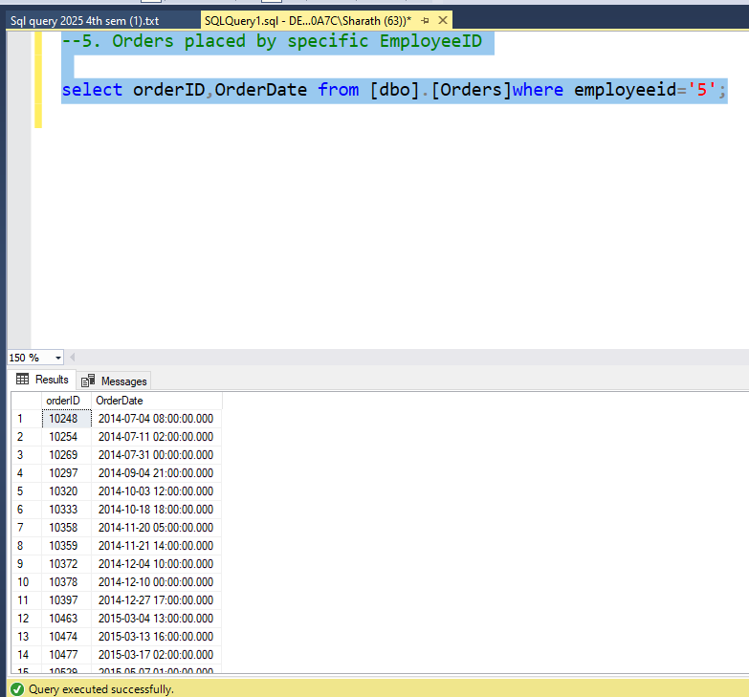
2.certain fields from categories
question
5.ordder placed by specific bemployee
query
select*from [dbo].[Employees];
select orderID,OrderDate from [dbo].[Orders]where employeeid='5';
output
Go Back to Agenda Page

Slide 9
question
5.order placed by specific employee
query
select*from [dbo].[Employees];
select orderID,OrderDate from [dbo].[Orders]where employeeid='5';
output
Go Back to Agenda Page

Slide 10
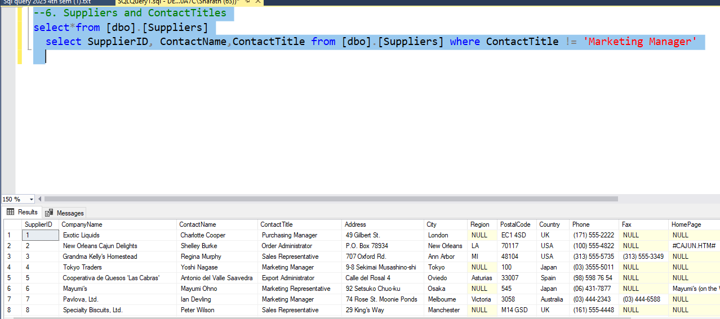
question
6.suppliers and contact title
query
select*from [dbo].[Suppliers]
select SupplierID, ContactName,ContactTitle from [dbo].[Suppliers] where ContactTitle != 'Marketing Manager'
output
Go Back to Agenda Page

Slide 11
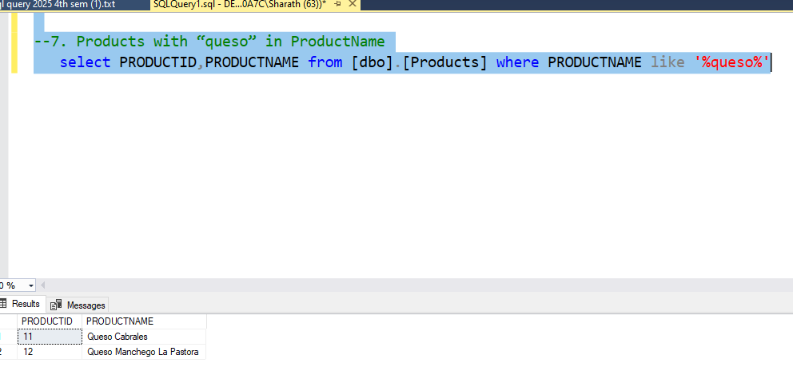
question
7.products with “queso” in productname
query
select PRODUCTID,PRODUCTNAME from [dbo].[Products] where PRODUCTNAME like '%queso%'
output
Go Back to Agenda Page

Slide 12
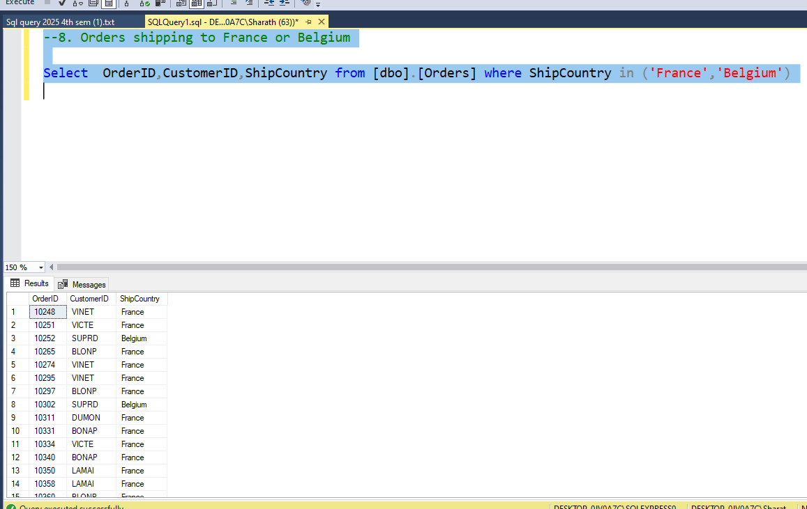
question
8.order shipping to france and belgium
query
Select OrderID,CustomerID,ShipCountry from [dbo].[Orders] where ShipCountry in ('France','Belgium')
output
Go Back to Agenda Page

Slide 13
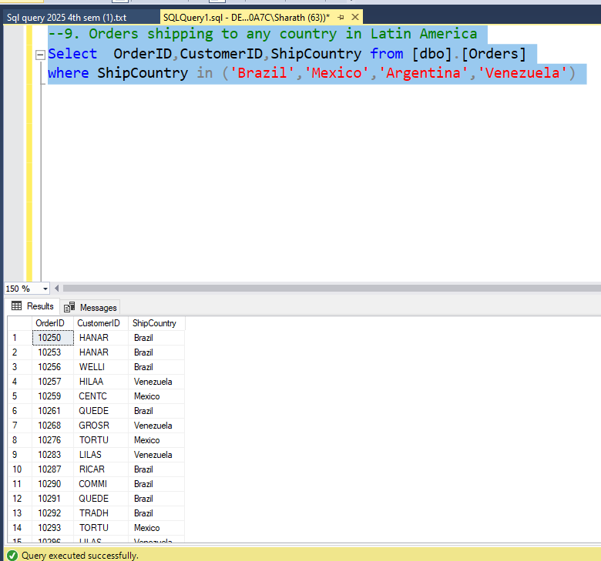
question
9.orders shipping to any country in latin america
query
Select OrderID,CustomerID,ShipCountry from [dbo].[Orders] where ShipCountry in ('Brazil','Mexico','Argentina','Venezuela')
output
Go Back to Agenda Page

Slide 14
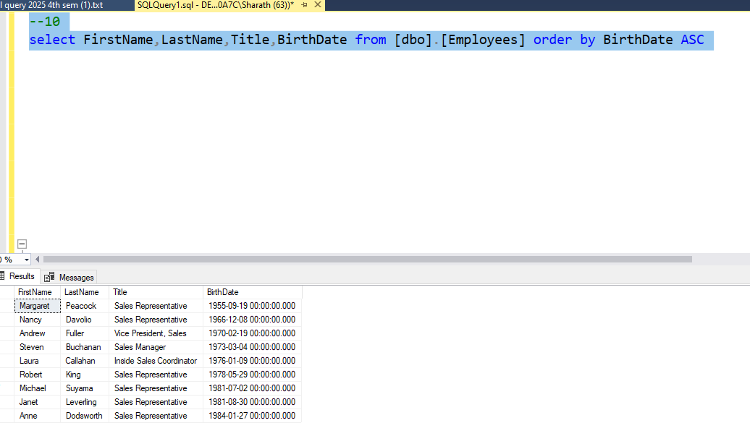
question
10.employess in order of age
query
select FirstName,LastName,Title,BirthDate from [dbo].[Employees] order by BirthDate ASC;
output
Go Back to Agenda Page

Slide 15
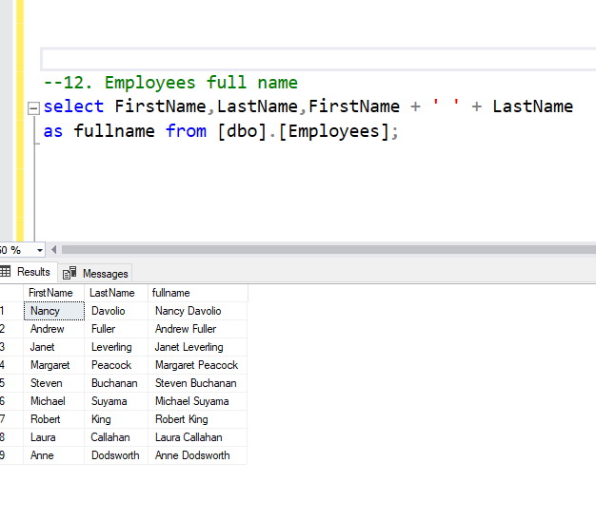
question
12.employee full name
query
select FirstName,LastName,FirstName + ' ' + LastName as fullname from [dbo].[Employees]
output
Go Back to Agenda Page

Slide 16
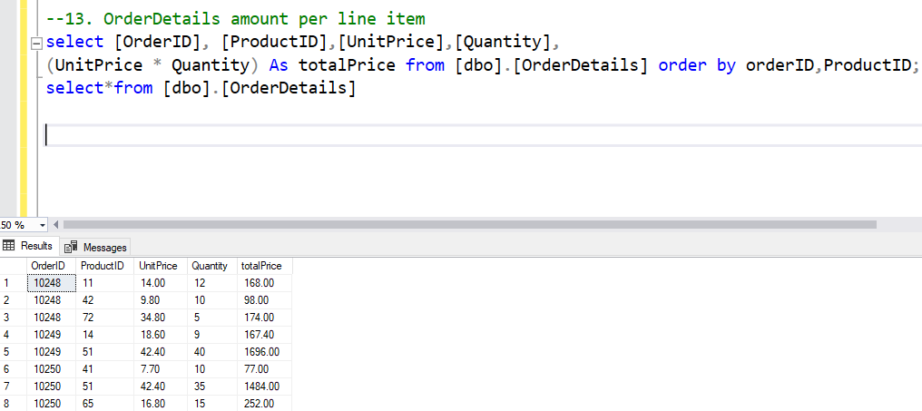
question
13.orderdetails amount per line item
query
select [OrderID], [ProductID],[UnitPrice],[Quantity],
(UnitPrice * Quantity) As totalPrice from [dbo].[OrderDetails] order by orderID,ProductID;
output
Go Back to Agenda Page

Slide 17
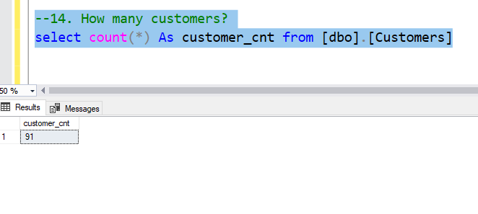
question
14.how many customers
query
select count(*) As customer_cnt from [dbo].[Customers]
output
Go Back to Agenda Page

Slide 18
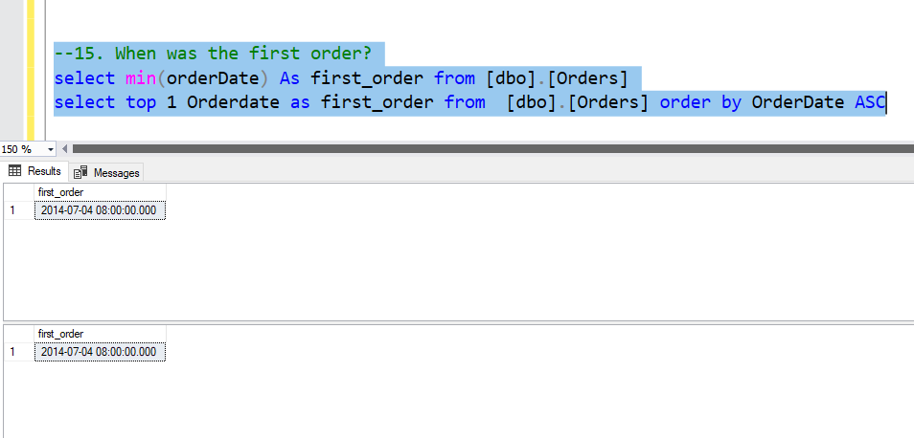
question
15.when was the first order
query
select min(orderDate) As first_order from [dbo].[Orders]
select top 1 Orderdate as first_order from [dbo].[Orders] order by OrderDate ASC
output
Go Back to Agenda Page

Slide 19
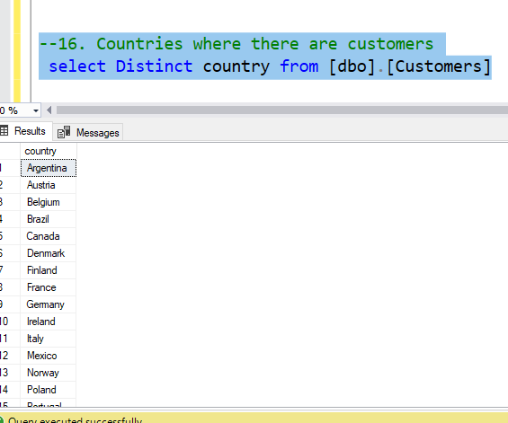
question
16.countries where there are customers
query
select Distinct country from [dbo].[Customers]
output
Go Back to Agenda Page

Slide 20
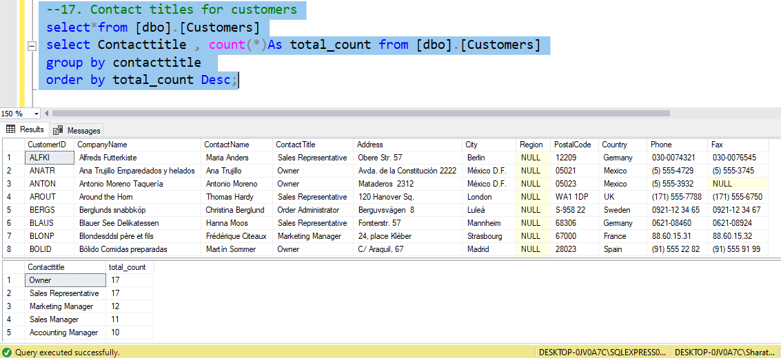
question
17.contact titles for customers
query
select*from [dbo].[Customers]
select Contacttitle , count(*)As total_count from [dbo].[Customers]
group by contacttitle
order by total_count Desc;
output
Go Back to Agenda Page

Slide 21
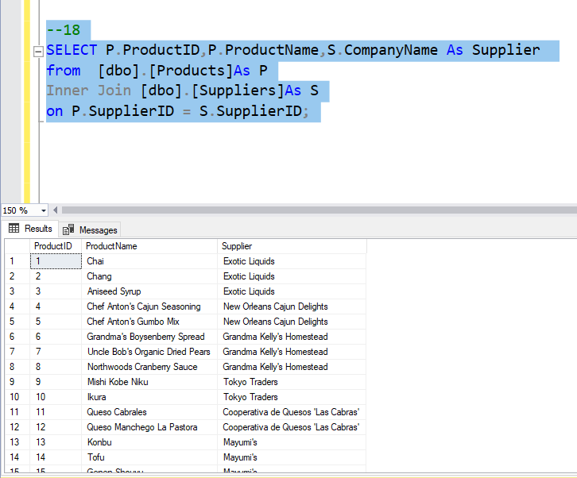
question
18.product with associated suppliers name
SELECT P.ProductID,P.ProductName,S.CompanyName As Supplier
from [dbo].[Products]As P
Inner Join [dbo].[Suppliers]As S
on P.SupplierID = S.SupplierID;
query
output
Go Back to Agenda Page

Slide 22
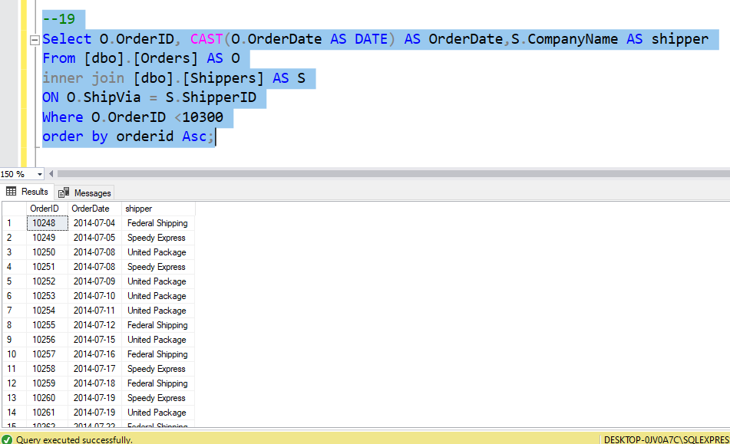
question
19.orders and shipper that was used
query
Select O.OrderID, CAST(O.OrderDate AS DATE) AS OrderDate,S.CompanyName AS shipper
From [dbo].[Orders] AS O inner join [dbo].[Shippers] AS S ON O.ShipVia = S.ShipperID Where O.OrderID <10300 order by orderid Asc;
output
Go Back to Agenda Page

Slide 23
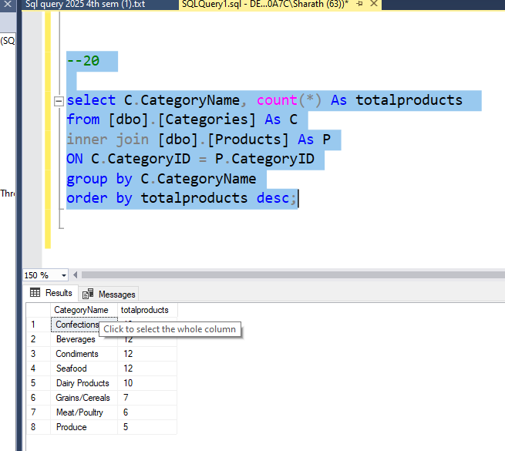
question
20.categories and total products in each category
query
select C.CategoryName, count(*) As totalproducts from [dbo].[Categories] As C inner join [dbo].[Products] As P ON C.CategoryID = P.CategoryID group by C.CategoryName order by totalproducts desc;
output
Go Back to Agenda Page

Slide 24
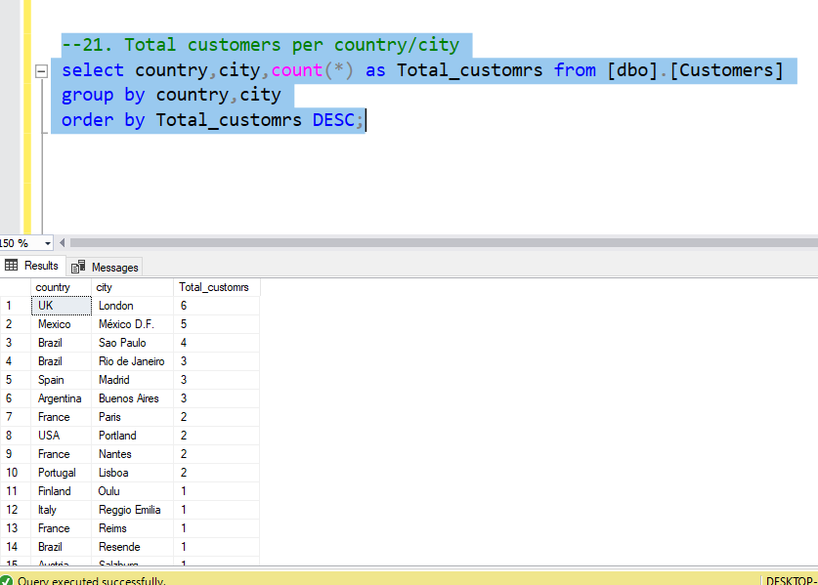
question
21.total coustomers per country/city
query
select country,city,count(*) as Total_customrs from [dbo].[Customers] group by country,city
order by Total_customrs DESC;
output
Go Back to Agenda Page

Slide 25
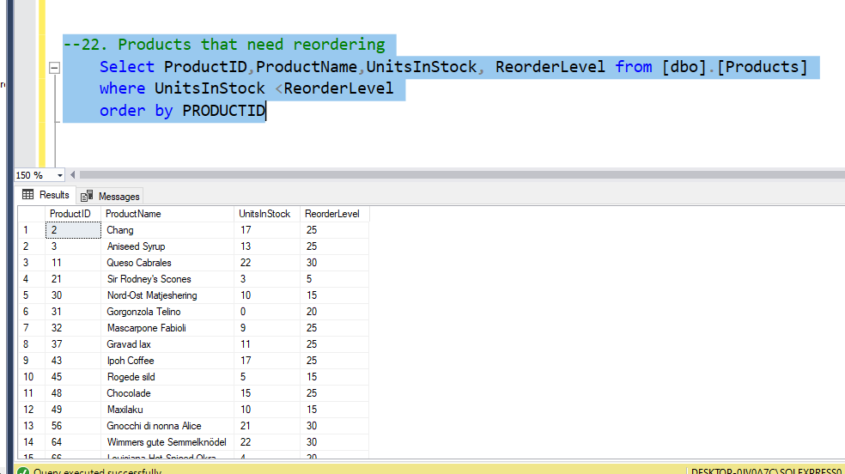
question
22.products that need reordering
query
Select ProductID,ProductName,UnitsInStock, ReorderLevel from [dbo].[Products]
where UnitsInStock <ReorderLevel
order by PRODUCTID
output
Go Back to Agenda Page

Slide 26
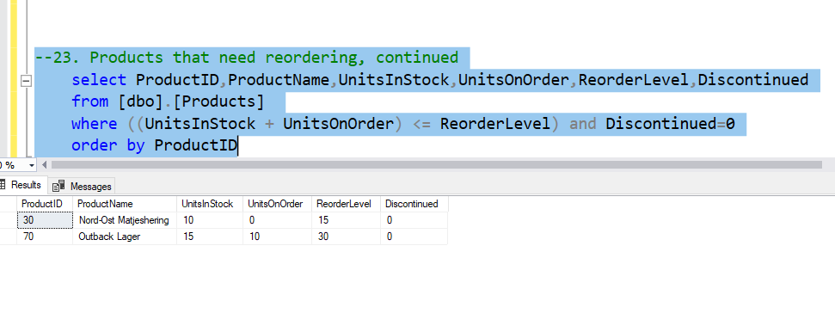
question
23.products that need reordering continued
query
select ProductID,ProductName,UnitsInStock,UnitsOnOrder,ReorderLevel,Discontinued
from [dbo].[Products]
where ((UnitsInStock + UnitsOnOrder) <= ReorderLevel) and Discontinued=0 order by ProductID
output
Go Back to Agenda Page

Slide 27
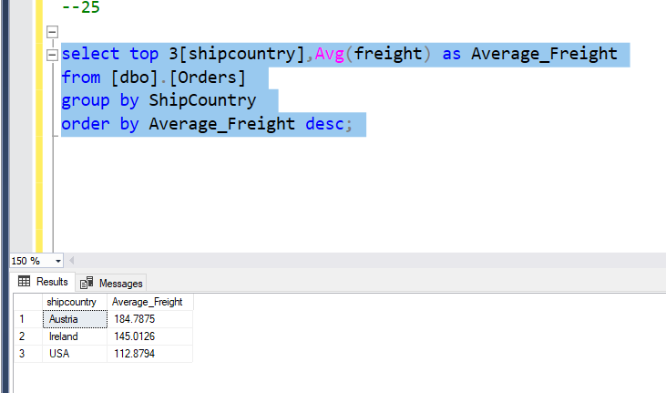
question
25.high freight charges
query
select top 3[shipcountry],Avg(freight) as Average_Freight from [dbo].[Orders] group by ShipCountry order by Average_Freight desc;
output
Go Back to Agenda Page

Slide 28
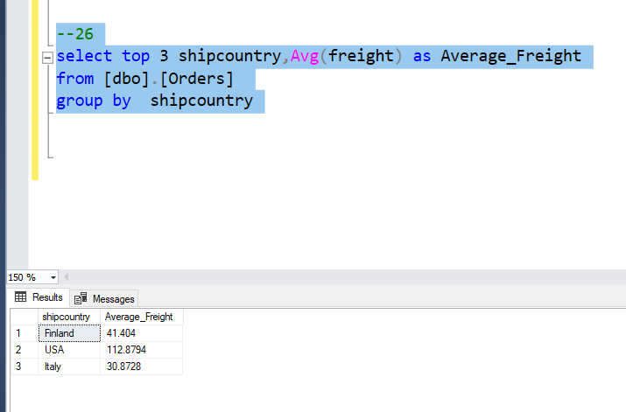
question
26.high freight charges-2015
query
select top 3 shipcountry,Avg(freight) as Average_Freight
from [dbo].[Orders]
group by shipcountry
output
Go Back to Agenda Page

Slide 29
Thank you!
prepared by Likitha.N(BDA238955)

